Slide 1
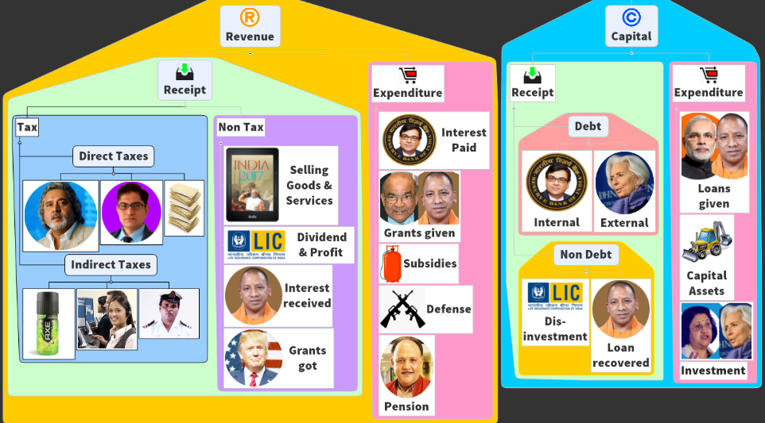
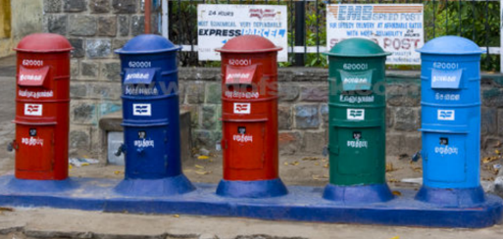
BES172: Budget →Revenue → Receipts → Non-Tax
GST
Black Money
Fiscal Deficit &
FRBM Panel under N.K.Singh

Slide 2
Sources of non-tax revenue: budget 2017 (Rs. Cr)
Profit Interest Dividend received
Services
Economic Services
General, Police & Defense Services
Social Services
Fiscal services (least among all non-tax)
(Foreign) Grants received
Dividend & Profit
Interest
[00] from railways
3k: Cash
2k: material
Decreasing order
Railways: 1.88 lakh cr. [▲]
Decreasing order
Decreasing order
Because no separate rail budget. So general budget need not give them “support” So they don’t have to pay “Dividend”
More under BES17 ”5” (infra)
Coin, Currency, minting, security press

Slide 3
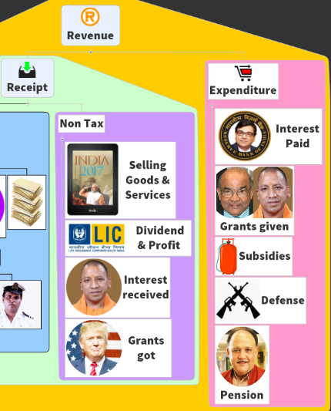

in earlier times, subsidies used to be second highest revenue expenditure.
5 lakh cr.
DECREASING ORDER
3 lakh cr.
14th FC self study
2.72 lakh cr.
1.8 lakh cr.
1.5 lakh cr.
7th Pay Commission self study

Slide 4
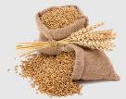



1.4L (▲)
5 lakh cr.
DECREASING ORDER
70k (=)
Urea (▼)
NBS (P,K)
3 lakh cr.
14th FC self study
2.72 lakh cr.
1.8 lakh cr.
Petroleum : 25k (▼)
LPG>> Kerosene
1.5 lakh cr.
ISS: 15k cr [▲]
7th Pay Commission self study

Slide 5

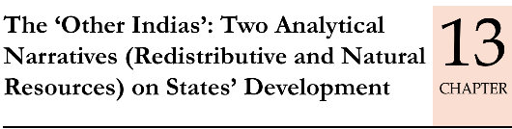

BES172: Budget 2017-> Capital Part
Loan, finance, investment type things
5.4 Lcr.
46kcr.
Fiscal Deficit &
FRBM Panel under N.K.Singh
For the speed and ease in revision, I’ll teach these three chapters at once in next lecture. For the moment, let’s just finish budget parts & fiscal deficit.

Slide 6
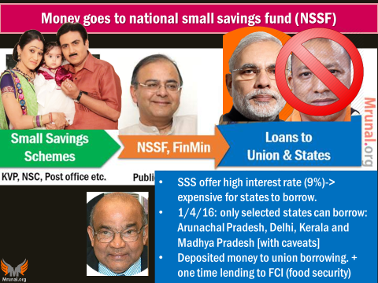
Budget ► Capital ► Receipt ► Debt ► Internal
Market Loans
T-Bill: 14 (Max), 91,182,364
Cash Management Bills (CMB)
Not part of “borrowing”
MSS [Monetary Policy]
Ways and Means advances [temporary cash mismatch]
Small Savings Schemes (8+1) [NSSF [Public Account]->Union Debt]
Not counted in fiscal deficit

Slide 7
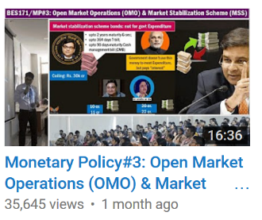
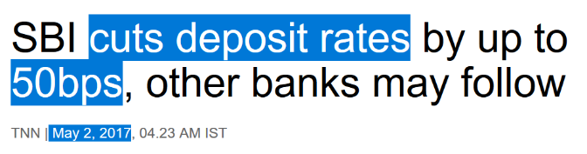
Budget ► Capital ► Receipt ► Debt ► Internal (Rs. Cr)
Market Stabilization Scheme (MSS): why such sharp rise?

Slide 8
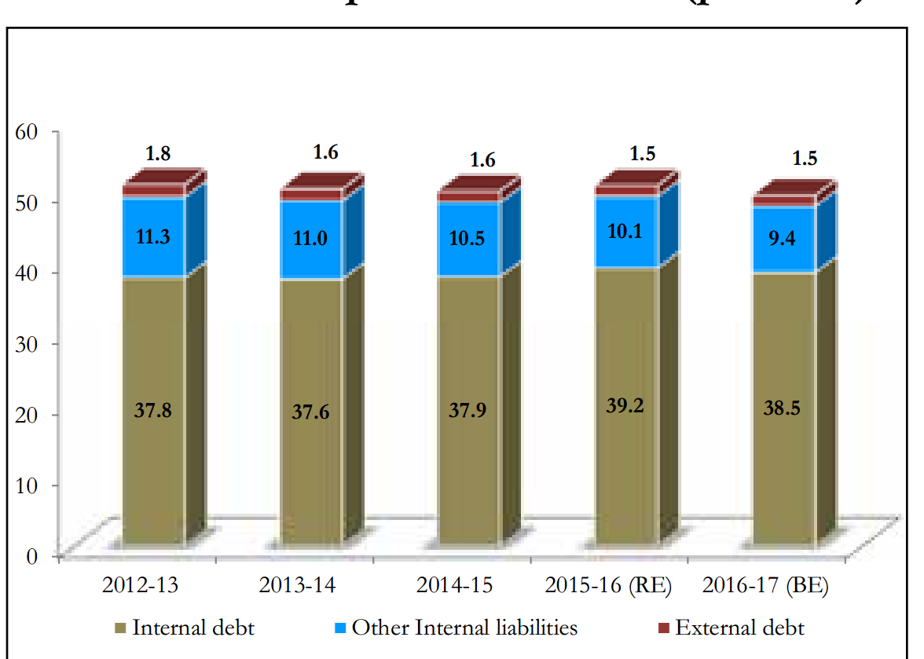
Internal & External Liability = from Consolidated Fund (Art. 266)
Total debt (liability)
Other internal Liabilities
Provident Fund
Small Savings
Internal
External
PLI
Other liabilities paid by Public Account (266)

Slide 9
Budget 2017: Capital Part
Loan, finance, investment type things
6.3 Lcr.
Market borrowing
5.46 Lcr.
Given & repaid
72kcr
11kcr.

Slide 10
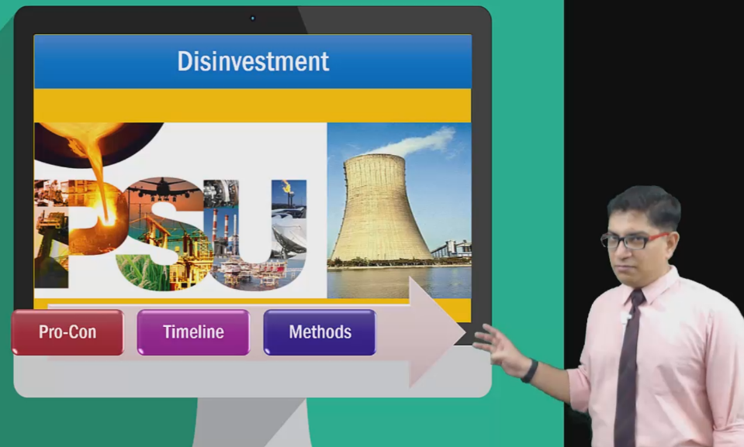
Self study Korbe chaalo: https://www.youtube.com/watch?v=hj2DROj-6q0

Slide 11
Disinvestment & “MERGERS”
ETF with more PSU <explained in BES171/Finance>
Shares of Railway PSEs like IRCTC, IRFC and IRCON will be listed in stock exchanges. <more BES17 “5” infra>
Strengthen our CPSEs through consolidation, mergers and acquisitions- create “Oil Major” to match the performance of international and domestic private sector oil and gas companies.
Budget 2017

Slide 12
Budget ► Capital ► Receipt ► Non Debt ► Disinvestment

Slide 13
Budget: Capital Part
3.09 Lcr.
6.3 Lcr.
Market borrowing
5.46 Lcr.
Given & repaid
DECREASING ORDER
72kcr
11kcr.

Slide 14
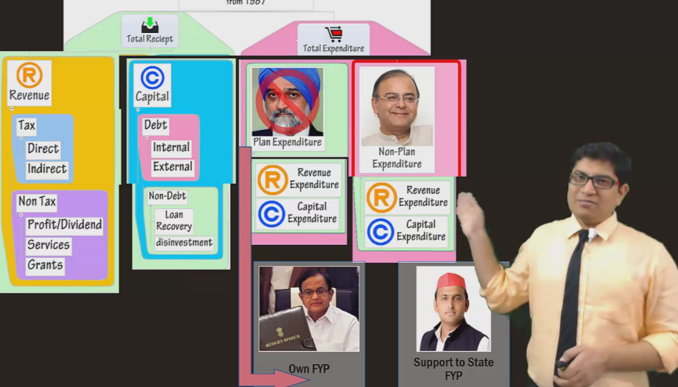
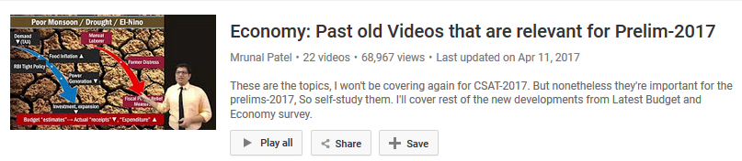
Why plan-non-plan merged: SELF STUDY Link

Slide 15

If Plan-Non Plan gone, Then where are the SCHEMES?
Scheme
9.45 lcr.
Revenue 6.74 lcr.
Capital 2.71 lcr.

Slide 16
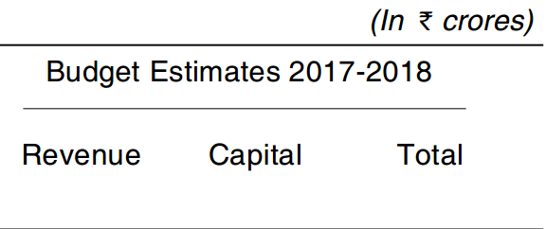
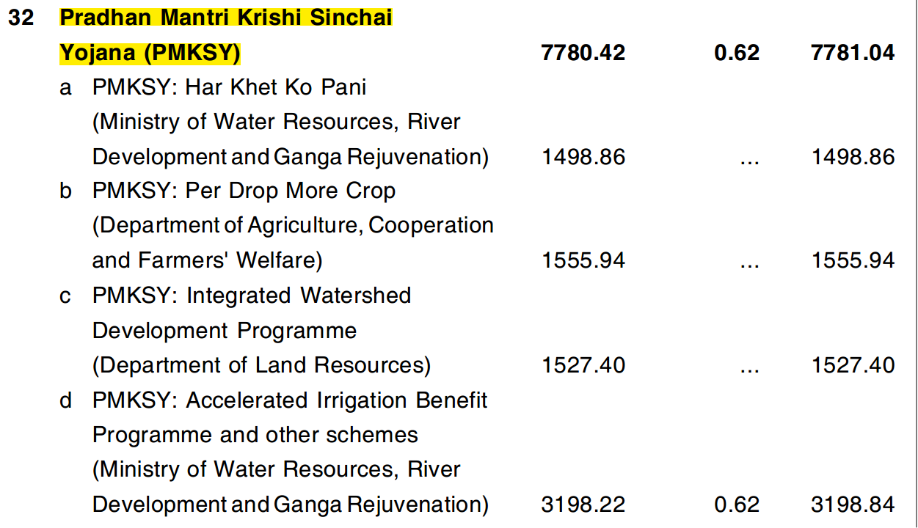
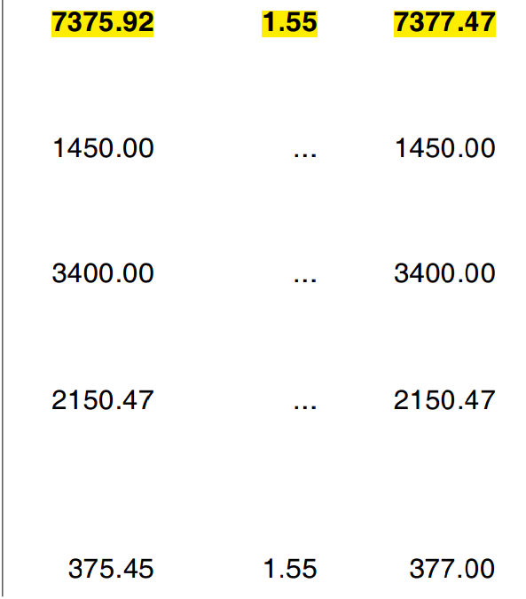
Specific schemes, we’ll study
1. Skill dev: BES17 “4”
2. Rural development, urban development: BES17 “5”
3. Human development (Poverty, food, edu.): BES17 “6”
4. What is CSS, Core scheme? NEXT video with UBI.

Slide 17
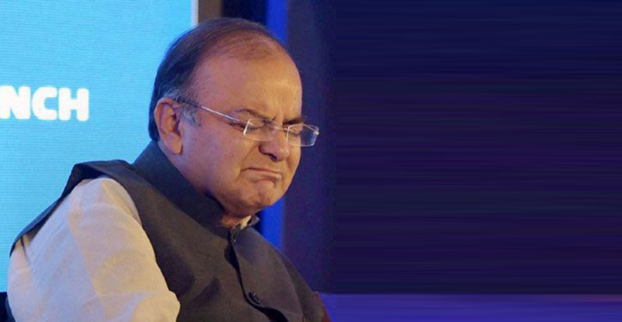
Fiscal Deficit for Budget 2017
Calculation
Why high level is Bad for economy?
N.K.Singh FRBM PANEL?
Figures for 2017
PDMA?

Slide 18
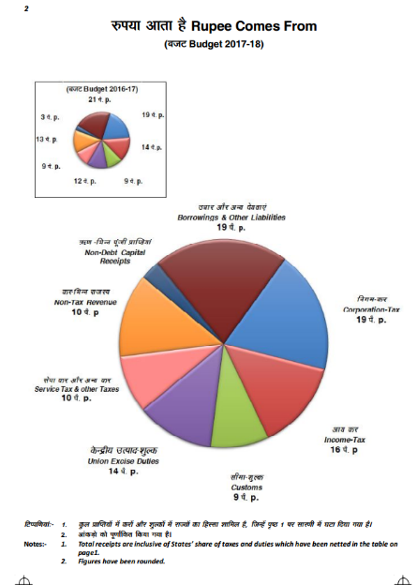
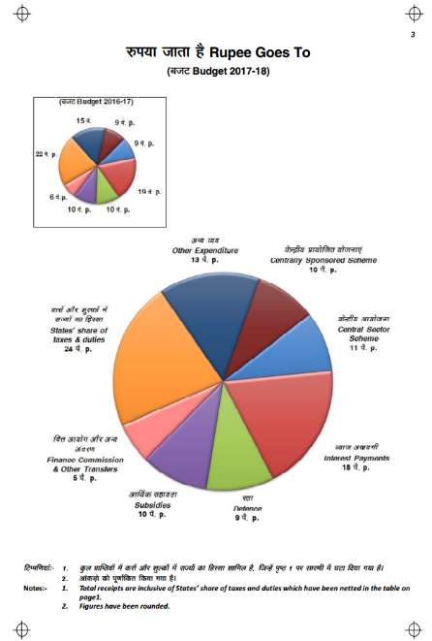

Slide 19
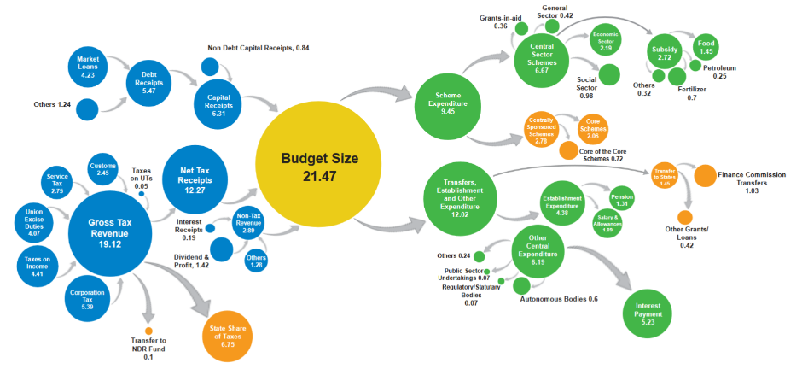
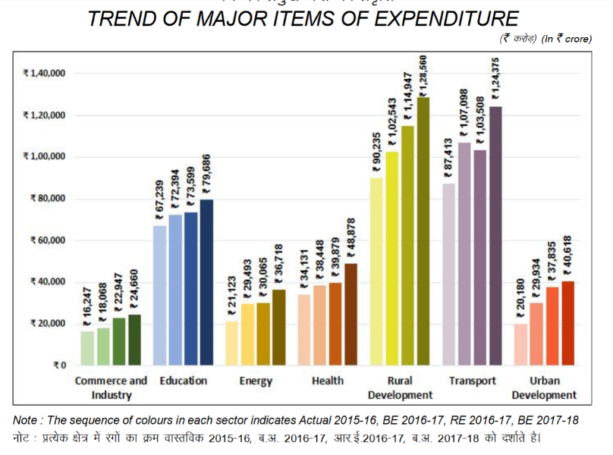
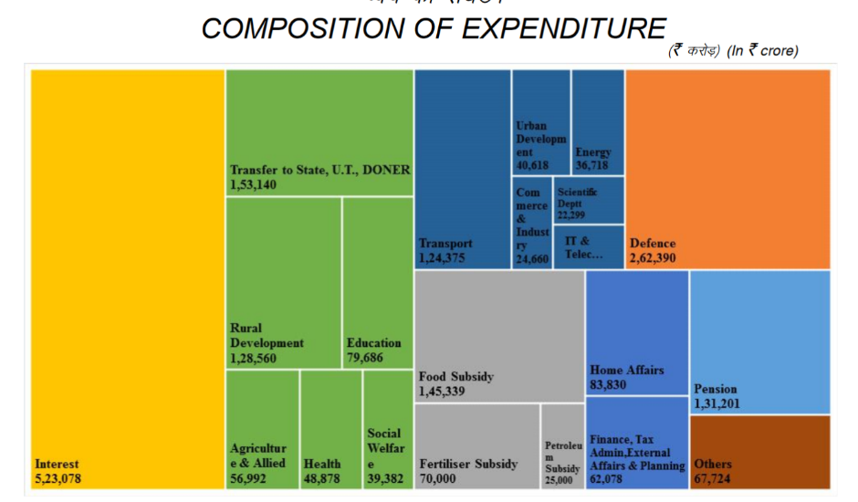

Slide 20
GDP (current prices) without adjusting for inflation (CSO) Rs. crore
2016-17
150,75,429 crore
Growth rate
11.75% (“Nominal”: inflation not adjusted)
2017-18
168,47,455 crore (GDP @current prices)
Real Growth Rate?
6¾-7½%
More in BES17 “4^{th”} pillar

Slide 21
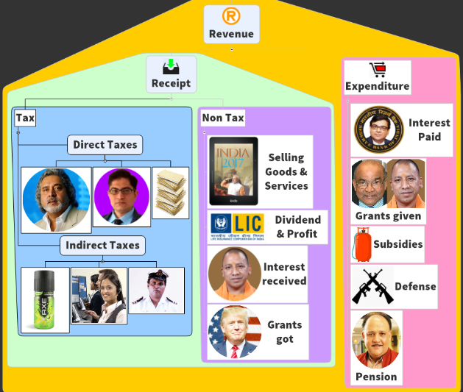
Deficit calculation: Revenue Deficit for 2017-18
RD: 3.21 L cr.
Divided by
GDP: 168.47 Lcr.
18.36 Lcr.
15.15 Lcr.
RD as a % of GDP
1.9%
Disaster, PRI bodies, filling State’s own deficit
..some of that may by utilized for capital assets? (1.95 l cr)

Slide 22
Effective Revenue Deficit (ERD) 2017-18
but 1.95 Lcr. grants are used for creation of capital assets? So subtract that
Effective Revenue Deficit:
Rs. 1.25, 813 Lcr.
Revenue Deficit:
Rs. 3,21,163 Cr
1.9%
0.7%
GDP 168,47,455
LCr. @Current Price

Slide 23
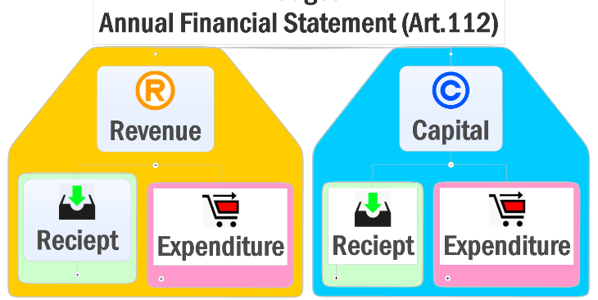
Let’s calculate budget deficit for 2017-18?
Budget
Deficit
__?
+15 Lcr.
-18 Lcr.
+6 Lcr.
-3 Lcr.

Slide 24
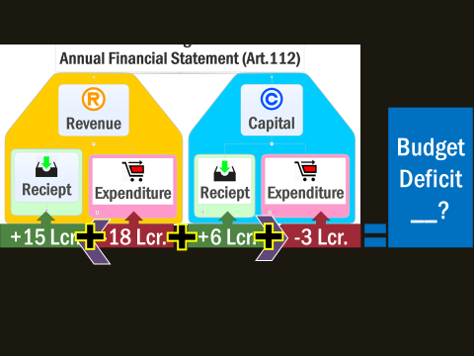
How did Budget-2017 have zero deficit!!??
-3.* Lcr.
-3.* Lcr.
+15.* Lcr.
-18.* Lcr.
Market borrowing
5.46 Lcr.
72kcr
11kcr.
(-3.*-3.*)+ 0.72+0.11= -5.46 Lcr.

Slide 25
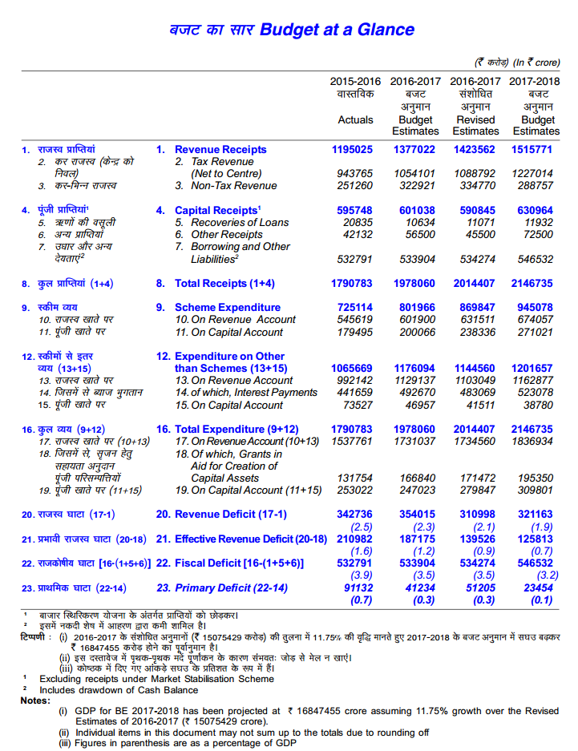
Manmohan
Mentioned in Budget 1993 documents
Primary
Deficit (0.1%)
Interest
Payments on old loans
Fiscal
Deficit (3.2%)
For 2017-18
+ Market
Borrowing
Budget
Deficit (0)
Sukhmoy Chakravarti: 97-98

Slide 26
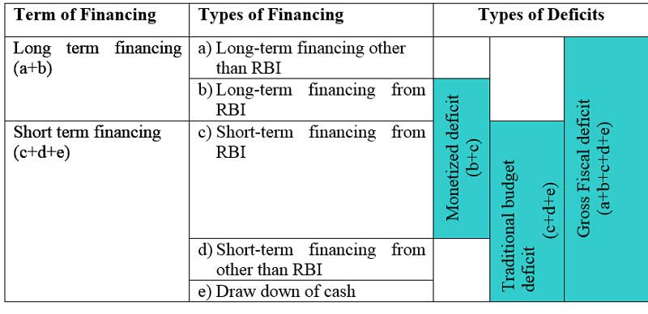
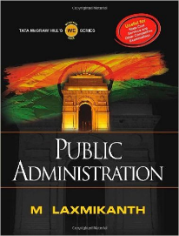
Homework: Read chapter
Financial Administration (if time permits)

Slide 27
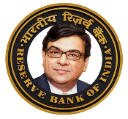



Why High fiscal deficit is bad for economy?
Sovereign Bond rating ▼
Market borrowing ▲
RBI ?
PSB>SLR
Foreigners
Higher return?
BoP crisis?
Financial repression
Monetizing deficit
DDSLLY/RGSLLY
FDI relax vs employment
Residents
↑Tax: Collection↓ <Laffer>
Evasion, Parallel economy
Gold/real Estate
Inflation: Repo ▲
Black Money, Low Transmission of Monetary Policy, private sector deprived of capital
↑ User fees: Quality ↓

Slide 28
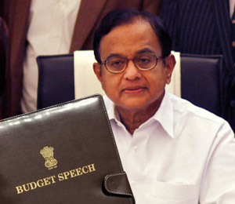
FRBM Act 2003- both union and states
Of GDP | Deadline
0% Revenue deficit | FY08
0% Effective RD | FY15
3% fiscal deficit | FY09
2%
FY15
Deduct the grants given for capital assets
Postponed. Due to GFC
Hum se naa ho paayegaa… ☹
Hence amendment 2012 (14th FC criticized)

Slide 29
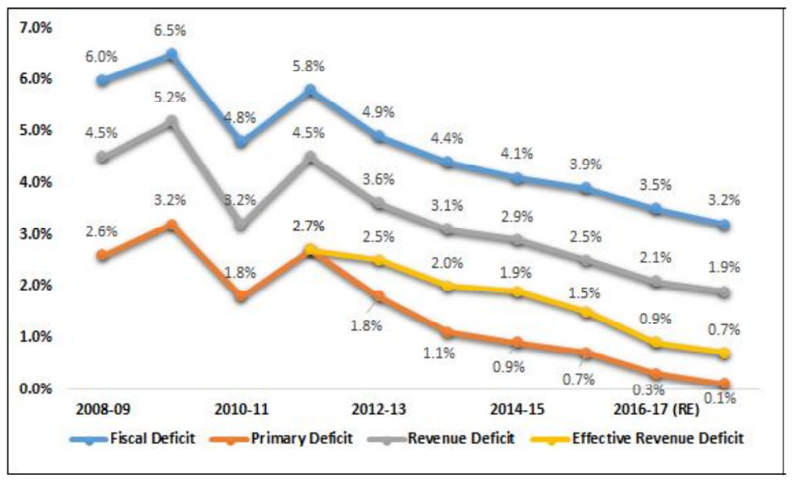
Fiscal “Stimulus”
Post-GFC

Slide 30
Mock Question
From Budget-2017, arrange the following from lowest to highest as a % of GDP?
Primary Deficit
Fiscal Deficit
Effective Revenue Deficit
Revenue Deficit.
Answer choices
1432
3142
1342
1324

Slide 31
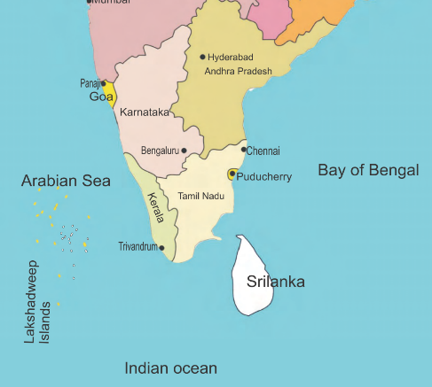
FRBM Reform
FRBM should have “range” rather fixed target
Will policy space in dynamic situation of global economy
Expert panel to review- union, state, academicians representatives.
Budget 2016
Protectionism
H1B Visa, 457 Visa
Return
What If State Government wants give unemployment allowance to these returned NRIs until they clear UPSC?
Can’t do because of ☹ FRBM targets

Slide 32
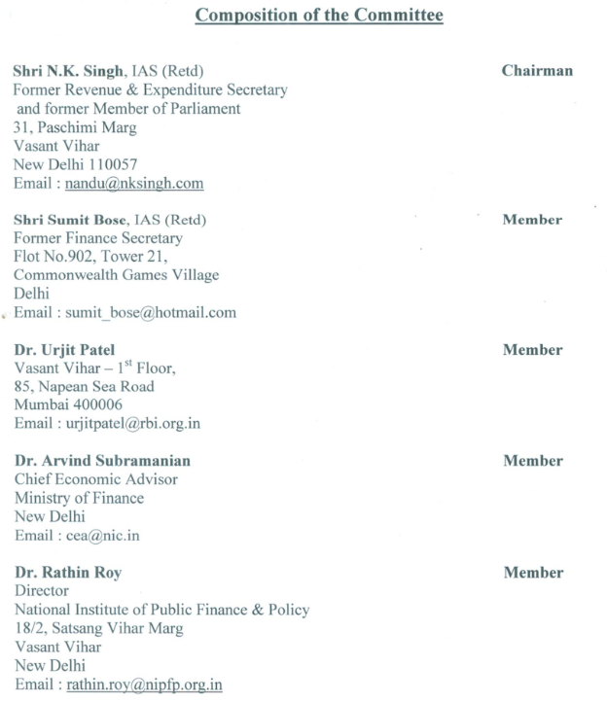

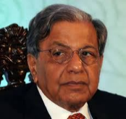

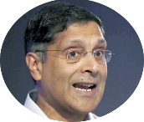
Dept of Economic Affairs
4 Volume. We’ll only see few things for prelims. Remaining in Mains.
May 2016-Jan 2017

Slide 33
Mock question
Who among the following is were members of the FRBM Review Panel constituted in 2016?
Niti Ayog Vice Chairman
Chief Economic Advisor
RBI Governor
Answer Choices
a) Only 1 and 2 (b) Only 2 and 3
c) Only 1 and 3 (d) All of them

Slide 34
FRBM Review Committee: Target for union deficit (% GDP)
Fiscal Deficit
Primary Deficit = 0%
Revenue Deficit
▼25 Basis Points

Slide 35
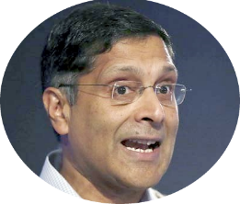


असहमति, the dissent
DISSENT: Focus on
“Primary Deficit”
instead of Fiscal deficit
Nahi, focus on Debt: GDP,
apart from fiscal deficit

Slide 36
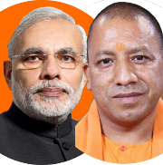
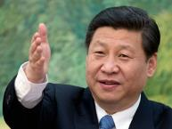
Because ….Our Debt to GDP is high ☹
And I’ve the lowest NPA among BRICS . You’ve second highest after Russia

Slide 37
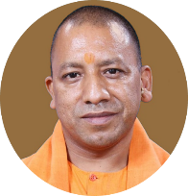
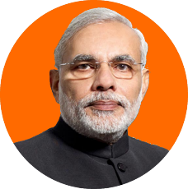
FRBM Panel: Debt to GDP target
~70%
60%

Slide 38

Monitoring: autonomous council Under FinMin (35+ nations have)
Autonomous Fiscal Council
Chairman
2 members
“Escape Clause”
Natural disaster
War, National Security
Agri. Collapse
As such FRBM Act 2003 also provides but ‘vaguely’. So, clearly define benchmark and Council monitoring to prevent misuse

Slide 39
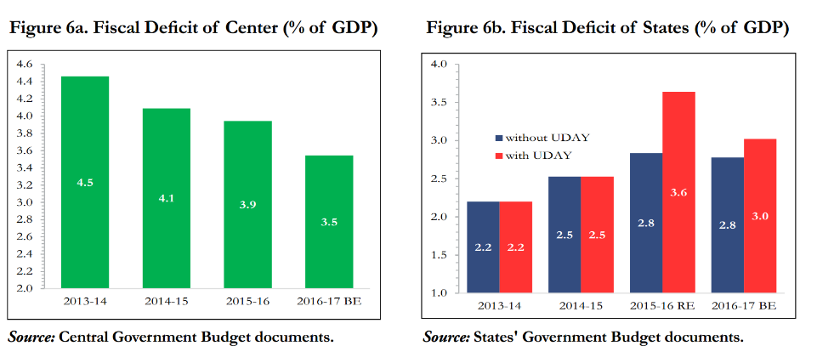
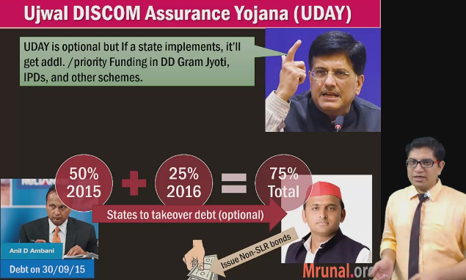
UDAY SCHEME
UDAY
FBRM Panel: 100% take over.
State Takes over Discomm Debt [75%]
Also, IndraDhanush 70k insufficient for BASEL-III recap. Need to give more. So,
Discom = State rescue
PSB = Union rescue

Slide 40
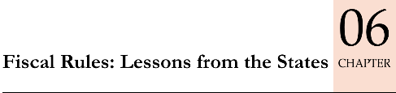
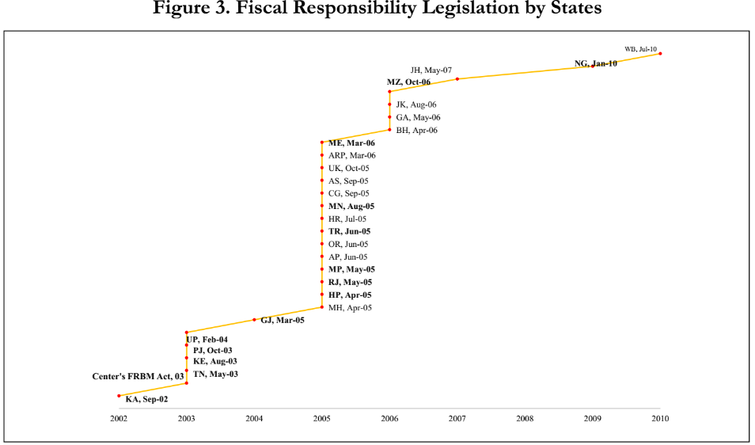
States adopted FRBM, and achieve targets..
W.Bengal’10
7th PC
UDAY Bonds repayment
Export Challenges, Slow Growth: FC, profession tax
GST: industrialized state. Cess, what after 5 years?
Karnataka’02
Resentment over Centrally imposed Prudence.. When union itself achieving targets ☹ <more in mains>
Notes:
For example, Kerala passed their FRL in 2003 while Haryana adopted theirs in 2005
FRL from other factors affecting fscal defcits, such as the 6th Pay Commission.
leSSonS for future fIScal ruleS
As the fscal challenges mount for the states going forward because of the Pay Commission recommendations, slowing growth, and mounting payments from the UDAY bonds, there is need to review how fscal performance can be kept on track
. Instead, there is a ?at relationship between the spread and the indebtedness of states – states are neither rewarded nor penalized for their debt performance (Figure 16). Similarly, there is no relationship between the coupon rate and the fscal defcit of states (see Figure 17). This owes in part to the manner in which auctions are conducted, which will have to be reviewed if a modicum of discipline is to be introduced into the conduct of state government fnances
centre has not only been imprudent but at the same time been the instrument of forcing prudence upon the states.
As the fscal challenges mount for the states going forward because of the Pay Commission recommendations, slowing growth, and mounting payments from the UDAY bonds, there is need to review how fscal performance can be kept on track

Slide 41
PDMA: Public Debt Management Agency / Authority
RBI: “conflict of interest”
PSB/LIC/EPFO
“New” PDMA:
Elsewhere?
Public Debt Manager
Monetary policy
“forced” to invest in G-Sec
Sell “G-Sec” on Voluntary Basis.
Yes, Sweden, NZ, Germany, Denmark etc have similar.
[inflation vs. deficit]
Fiscal repression of households,
Crowding out of Pvt sector.
Vijay Kelkar (13th FC), Justice BN Srikrishna (FSLRC), Past Surveys recommended

Slide 42
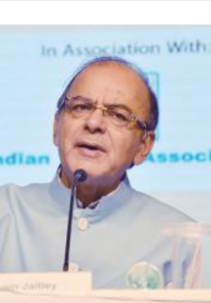
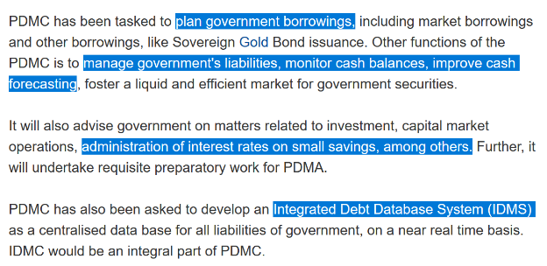
Public Debt Management Agency/ authority
PDMA
Budget 2015: Jaitley will do.
2016, Oct: Public Debt Management Cell @RBI Delhi office. [FinMin- selected work, personnel shifted]
In +2 years = statutory PDMA

Slide 43
BES172: Budget: Taxation, Black Money & Parts over.
NEXT TIME

